Slide 1
Object detection training model based on machine learning
Dong Wenyu

Slide 2
Task definition
The identification is carried out according to the example of objects provided by the dataset, through live video

Slide 3
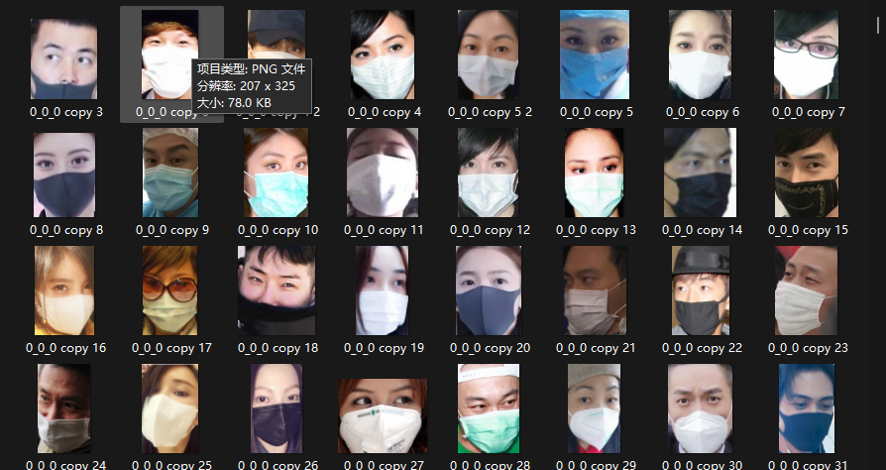
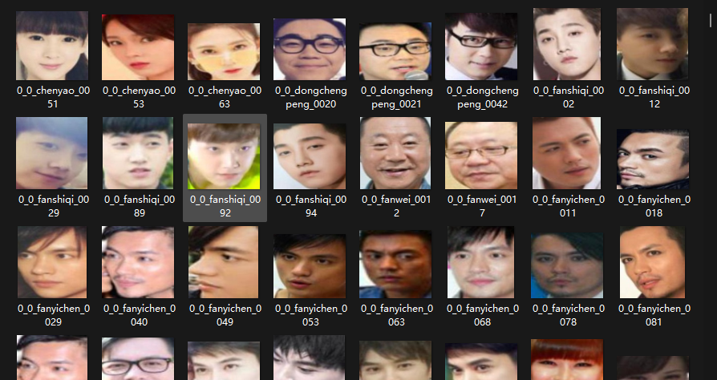
Data set overview
There were 659 images of faces with masks and 319 images of faces without masks.

Slide 4
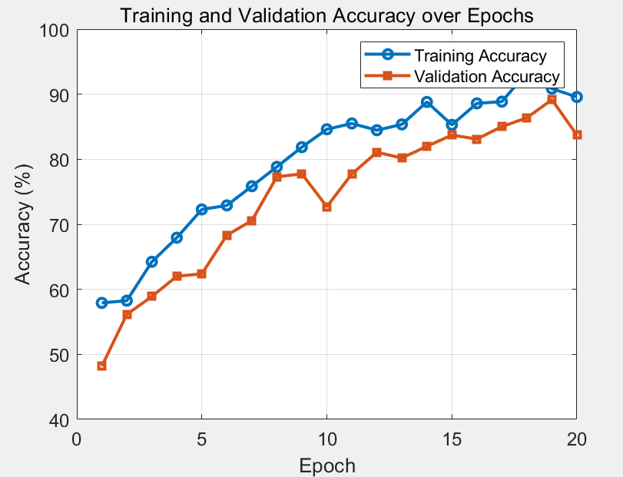
Model fusion and reward training model
Model fusion and reward training is one of the key strategies to create efficient and powerful deep learning models. So I combined the head classifier with the pre-trained MobileNetV2 base model.
Finally, the training accuracy is close to 95%, indicating that my model has certain generalization ability.

Slide 5
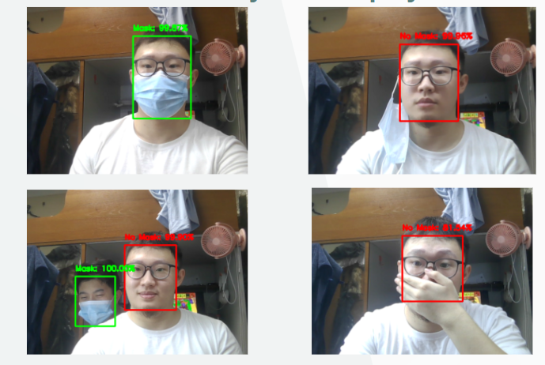
Real-time detection system display

Slide 6
Thank you

